Slide 1
Which Home Features Most Directly Affect Sale Price
By Alexander Lavelle

Slide 2
Our House Flipping Company wants to be able to understand how house features affect sale price
Accurate predictions will ensure we target the correct homes
Foreclosures, bank sales, and word-of-mouth can also, allow us to find inexpensive homes, but which ones will maximize our profit and time?
Want to use a model that predicts 50% of the data within 10 percent of true value

Slide 3
Data Source and Features, Original
Feature | Kind | Description | Included?
id | numerical |  | No – simply informative house id
date | datetime |  | No – simply informative date of sale
price | $, numerical | $75,000 to $7,700,000 | Yes – target data
sqft_living | area | 290 to 13,540; interior area | Yes – this describes the interior size of the house including basement
sqft_lot | area | 520 to 1,651,259; total lot area | Yes – want to know how large the plot of land the house sits on is
floors | numerical | 1 to 3.5 | Yes – gives us an idea of the physical size of the house
waterfront | categorical | 1 = Waterfront, 0 = !Waterfront | Yes – our heatmap shows some important relationships with price and low collinearity
view | categorical | 0 – 4, 4 being the best view | Yes – want to know something about view
condition | categorical | 1-5, 5 being in like new condition | Yes – want to have an idea of condition
grade | categorical | 1-13; 1-3 construction site, 7 average, 11-13 have high quality construction and design | Yes – want to know if it’s being built, or whether it is a full-scale, well-constructed house with beautiful features

Slide 4
Data Source and Features, Engineered
Feature | Kind | Description | Included?
newdate | date | Sale Date: May 2014 – May 2015 | No – sale date might be a confounding variable
renovated | categorical | 0 = no, 1 = renovated | Yes – a renovated house may ultimately be nicer
since_reno | numerical | 0 – 115, defaults to age if renovated=0 | Yes – a good measure for relative newness
has_basement | categorical | 0 – no, 1 = has a basement | Yes – a basement may be desirable
PctofLot | numerical | Living Area / Lot Area | Yes – gives us a good idea of homes vs. apartments, and indicates whether a home takes up its whole lot
age | Numerical | 0 – 115 | No – since_reno is a better measure and age had collinearity issues
latLongUseable | radian | These are K-Nearest Neighbor points converted from GPS coordinates in radians | Yes – price and proximity to Seattle proper are very important

Slide 5
Data Source and Features, Original, discarded
Feature | Kind | Description | Included?
bedrooms | Numerical | 1 – 10 | No – collinear with sqft_living
bathrooms | Numerical | .5 = half, 1 = full (including shower) | No – collinear with sqft_living
sqft_above | Area | 0 – 13,540 | No – collinear with sqft_living
sqft_basement | Area | 0 – 13,540 | No – collinear with has_basement
yr_built | Year | 1900 – 2015 | No – age / since_reno both better variables
yr_renovated | Year | 1900 – 2015 | No – since_reno + renovated better indicator
zipcode | Numerical | Zipcodes of Seattle Area | No – latLongUseable is correct format for modelling
Lat / long | Geographic | GPS Coordinates | No – latLongUseable is correct format for modelling
Sqft_living15 | Numerical | Mean of nearest 15 neighbors house interior areas | No – collinear with sqft_living
Sqft_lot15 | Numerical | Mean of nearest 15 neighbors house lot areas | No – collinear with sqft_lot

Slide 6
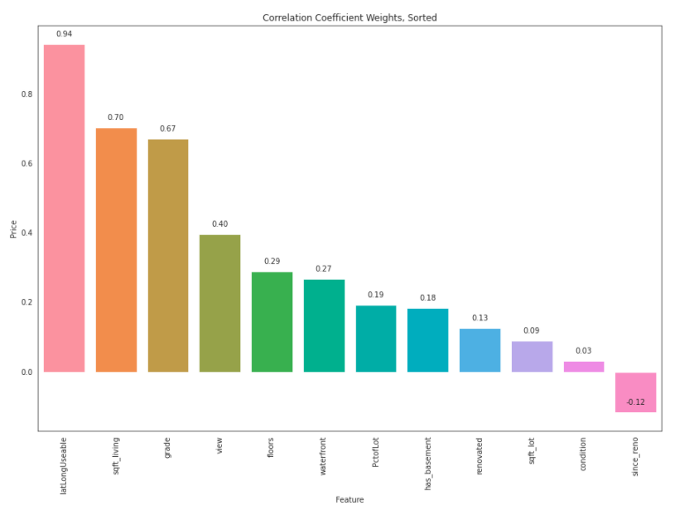
The correlation table of our features with price shows lat/long location to be a .94 relationship with price, with sqft_living at .70, and grade at .67

Slide 7
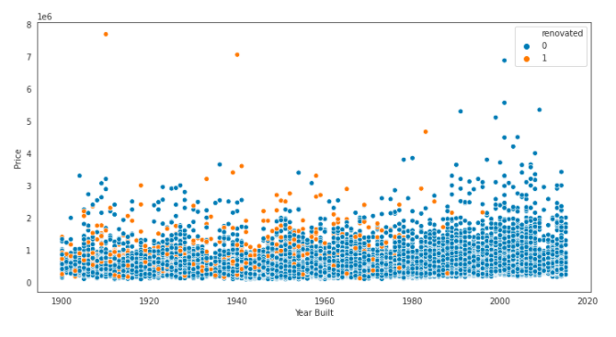
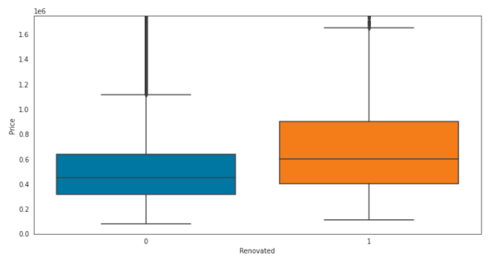
Whether a house is renovated or not can increase its mean sale price by $229k, or 43.02%

Slide 8
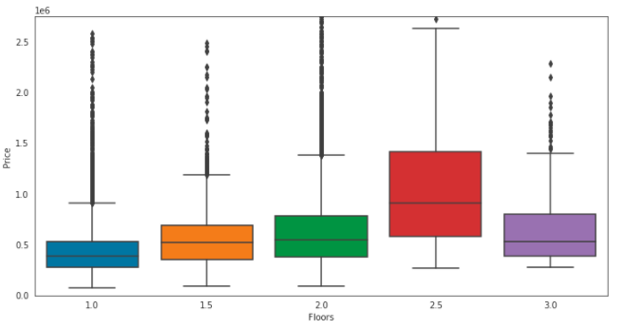
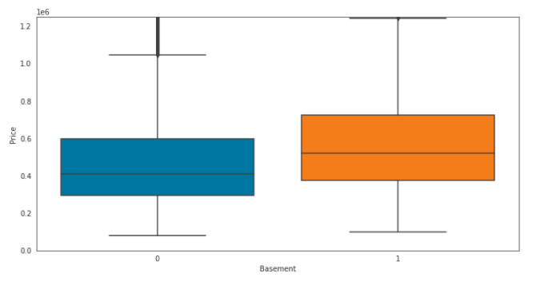
Floors may be indicative of apartments or extraordinarily large houses, but adding a basement can be an added $141k, or 28.9%

Slide 9
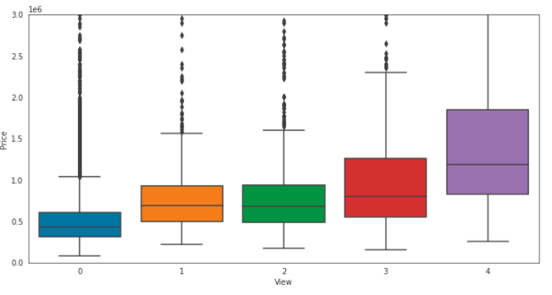
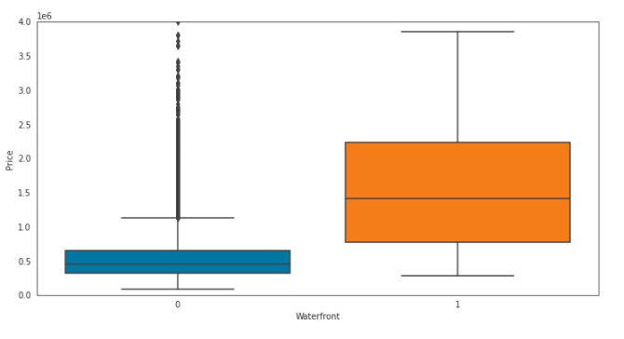
Having a superior 4* view increases mean house price $948k from the average price of the rest of houses, a 180% increase. Houses on the waterfront are by average $1.14M more expensive, a 213% increase

Slide 10
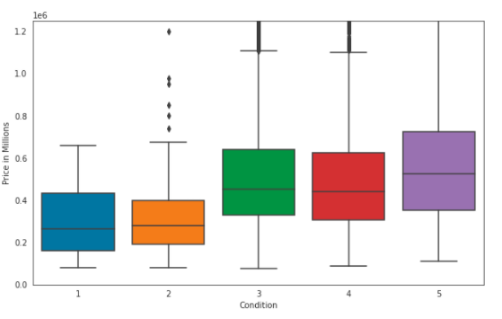
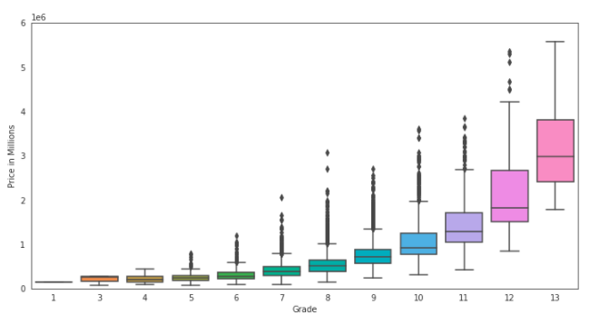
While condition contributes very little to price, Grade has an exponential relationship with price. A grade of 13 averages nearly $1M higher than grade 12. For condition, a score of 3 or above is a difference of $214k, or a 64.7% increase

Slide 11
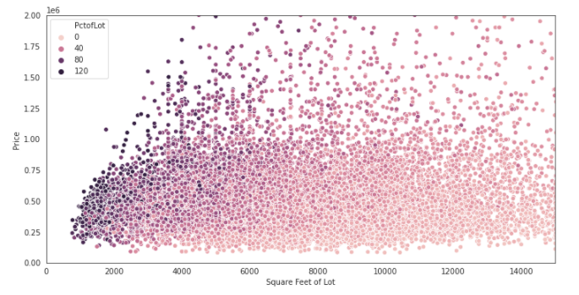
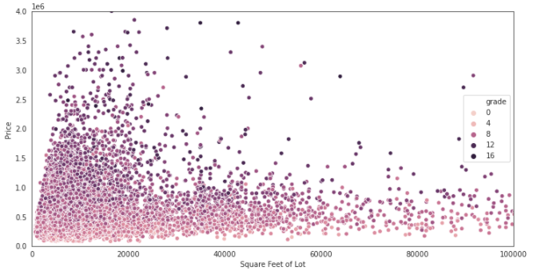
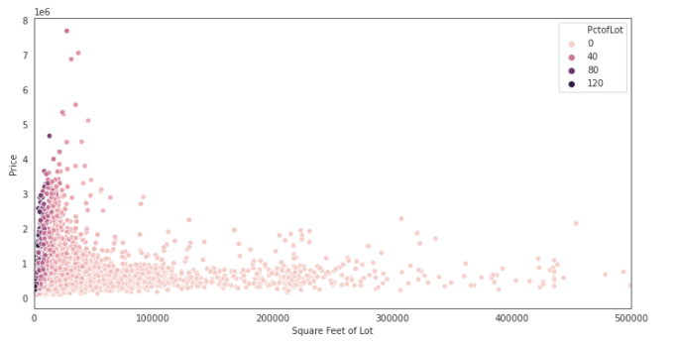
Square footage of the lot is not a perfectly linear relationship with price, but if we consider grade and the percentage of the lot filled by the house, we can explain some of the variation in prices

Slide 12
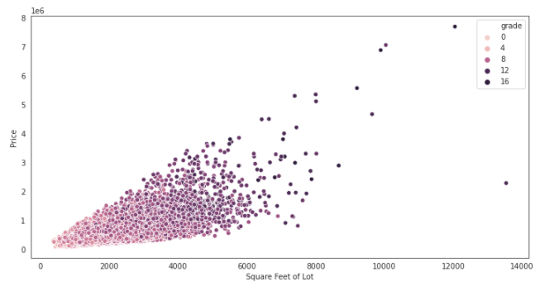
Square Feet is our best indicator of the contents of a house – a larger house in this dataset naturally tends to have more bathrooms. The range in prices increases with sqft
Notes:
This is a better measure than above or below ground as it represents the total square footage and not all homes have basements. That, and total squarefootage seems to matter much more. Bathrooms has been added as a proxy for “luxurious”

Slide 13
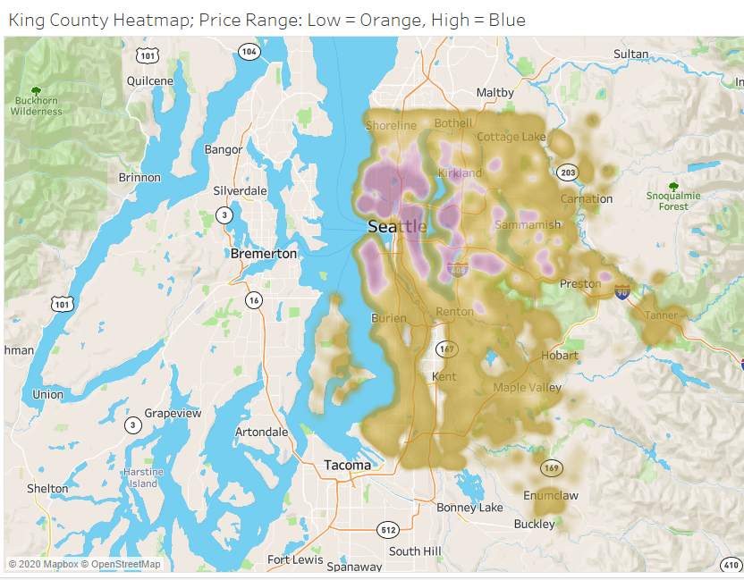
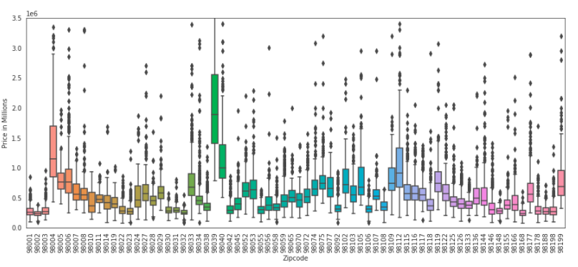
Zip Code on its own may be difficult to interpret, but lat/long does tell us quite a bit about pricing

Slide 14
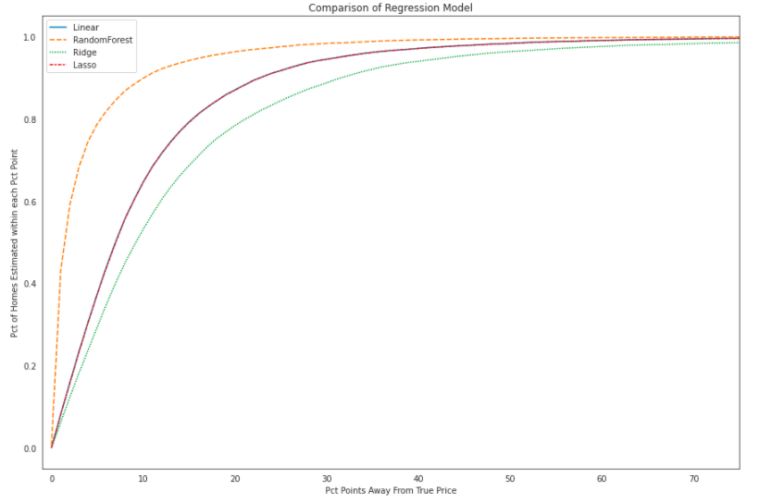
Of the regressions performed, the Random Forest is the most accurate in predicting price

Slide 15
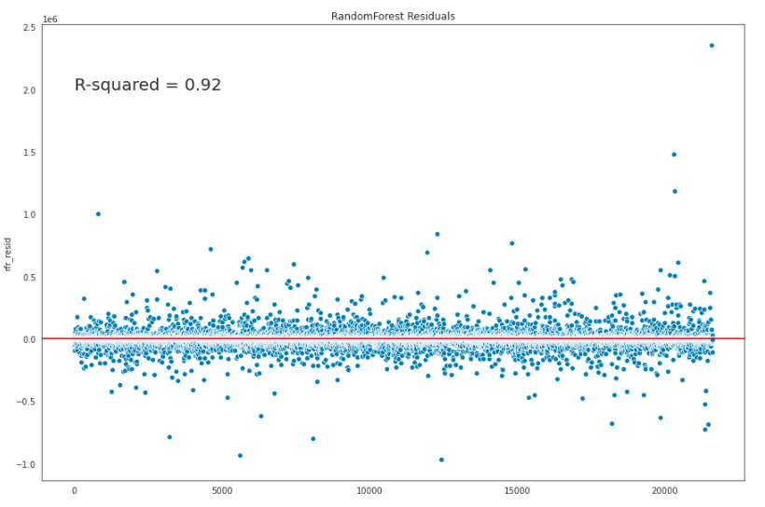
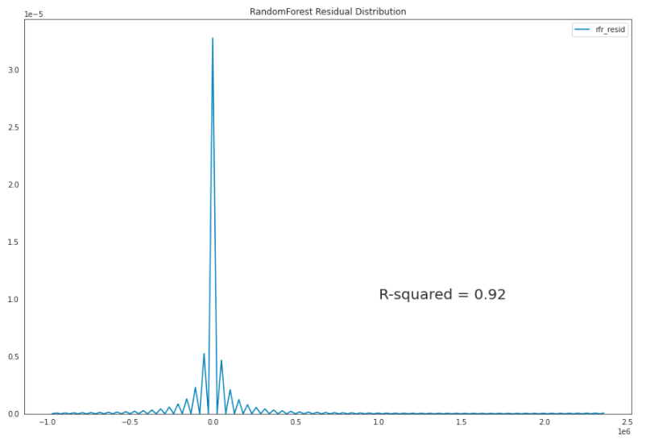
Our random forest model applied to the data returns a model for the data with R^2 = .922

Slide 16
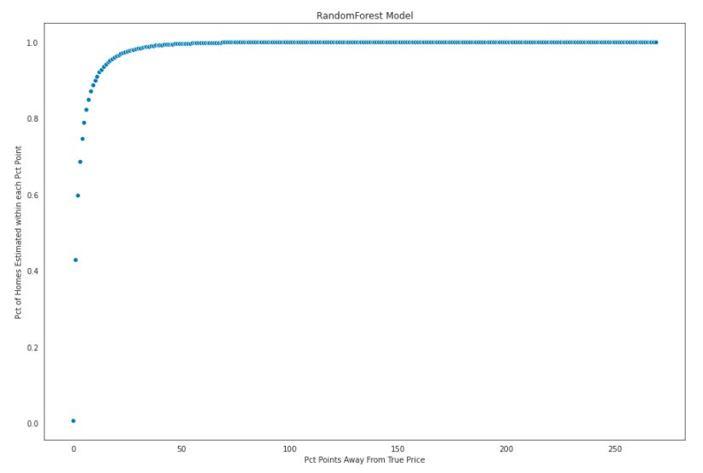

The random forest model attains an accuracy of 79.9% of predictions within 5% of the true price
Notes:
95% of predictions are within 17% of the true price

Slide 17
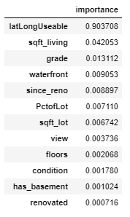
In terms of feature importance, the greatest impact on the final model comes from latLongUseable (90.4%), SqFt_living (4.20%), and Grade (1.31%)

Slide 18
Closing Summary
As they say in Real Estate, “Location, location, location!” - LatLongUseable has feature importance of .90
The random forest model attains an accuracy of 79% of predictions within 5% of the true price
Improvements for next phase
Some leakages present – slight collinearity despite choosing intelligently, way things have been calculated
Leakage from dataset itself – bias of grade / condition

